Slide 1
SIMD Instruction Set Extensions for Multimedia

Slide 2
SIMD Instruction Set Extensions for Multimedia
SIMD Multimedia Extensions for handling multimedia applications are:
        MMX (Multimedia Extensions)
        SSX (Streaming SIMD Extensions )
        AVX (Advanced Vector Extensions)
These extensions started with the simple observation that many media applications operate on narrower data types than the 32-bit processors were optimized for.
Many graphics systems used 8 bits to represent each of the three primary colors plus 8 bits for transparency. Audio samples are usually represented with 8 or 16 bits.
By partitioning the carry chains within, say, a 256-bit adder, a processor could perform simultaneous operations on short vectors of thirty-two 8-bit operands, sixteen 16-bit operands, eight 32-bit operands, or four 64-bit operands.
The additional cost of such partitioned adders was small.

Slide 3
SIMD Instruction Set Extensions for Multimedia
Like vector instructions, a SIMD instruction specifies the same operation on vectors of data.
Unlike vector machines with large register files, which can hold as many as sixty-four 64-bit elements in each of 8 vector registers, SIMD instructions tend to specify fewer operands and hence use much smaller register files.
SIMD extensions have three major omissions:
Multimedia SIMD extensions fix the number of data operands in the opcode.
Vector architectures have a vector length register that specifies the number of operands for the current operation.

Slide 4
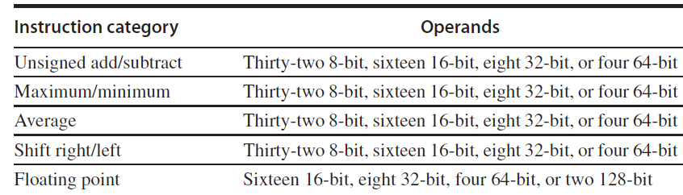
SIMD Instruction Set Extensions for Multimedia
2. Multimedia SIMD does not offer the more sophisticated addressing modes of vector architectures, namely strided accesses and gather-scatter accesses.
  These features increase the number of programs that a vector compiler can successfully vectorize.
3. Multimedia SIMD usually does not offer the mask registers to support conditional execution of elements as in vector architectures.

Slide 5
SIMD Instruction Set Extensions for Multimedia
These omissions make it harder for the compiler to generate SIMD code and increase the difficulty of programming in SIMD assembly language.
For the x86 architecture, the MMX instructions added in 1996 repurposed the 64-bit floating-point registers, so the basic instructions could perform eight 8-bit operations or four 16-bit operations simultaneously.
These were joined by parallel MAX and MIN operations, a wide variety of masking and conditional instructions, operations typically found in digital signal processors, and ad hoc instructions that were believed to be useful in important media libraries.
The Streaming SIMD Extensions (SSE) successor in 1999 added separate registers that were 128 bits wide, so now instructions could simultaneously perform sixteen 8-bit operations, or eight 16-bit operations, or four 32-bit operations.

Slide 6
SIMD Instruction Set Extensions for Multimedia
Intel soon added double-precision SIMD floating-point data types via SSE2 in 2001, SSE3 in 2004, and SSE4 in 2007.
Instructions with four single-precision floating-point operations or two parallel double-precision operations increased the peak floating-point performance of the x86 computers, as long as programmers place the operands side by side.
With each generation, they also added ad hoc instructions whose aim is to accelerate specific multimedia functions perceived to be important.
The Advanced Vector Extensions (AVX), added in 2010, doubles the width of the registers again to 256 bits and thereby offers instructions that double the number of operations on all narrower data types.

Slide 7
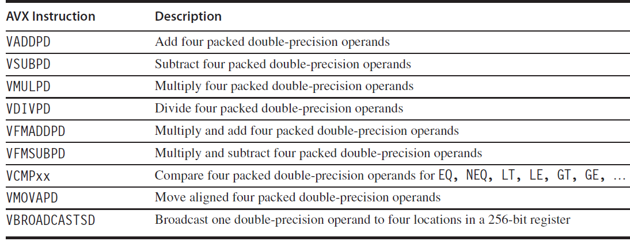
SIMD Instruction Set Extensions for Multimedia
Figure: AVX instructions for x86 architecture useful in double-precision floating-point programs

Slide 8
SIMD Instruction Set Extensions for Multimedia
Why are Multimedia SIMD Extensions so popular?
First, they cost little to add to the standard arithmetic unit and they were easy to implement.
Second, they require little extra state compared to vector architectures which is always a concern for context switch times
Third, you need a lot of memory bandwidth to support a vector architecture, which many computers don’t have.
Fourth, SIMD does not have to deal with problems in virtual memory when a single instruction that can generate 64 memory accesses can get a page fault in the middle of the vector.

Slide 9
SIMD Instruction Set Extensions for Multimedia
SIMD extensions use separate data transfers per SIMD group of operands that are aligned in memory, and so they cannot cross page boundaries.
Another advantage of short, fixed-length “vectors” of SIMD is that it is easy to introduce instructions that can help with new media standards, such as instructions that perform permutations or instructions that consume either fewer or more operands than vectors can produce.

Slide 10
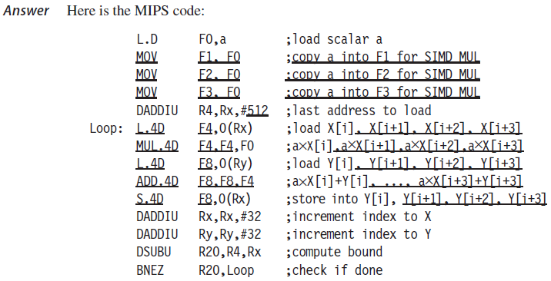
SIMD Instruction for DAXPY

Slide 11
SIMD Instruction Set Extensions for Multimedia
Programming Multimedia SIMD Architectures
By borrowing techniques from vectorizing compilers, compilers are starting to produce SIMD instructions automatically.
For example, advanced compilers today can generate SIMD floating-point instructions to deliver much higher performance for scientific codes.
However, programmers must be sure to align all the data in memory to the width of the SIMD unit on which the code is run to prevent the compiler from generating scalar instructions for otherwise vectorizable code.
The Roofline Visual Performance Model
One visual, intuitive way to compare potential floating-point performance of variations of SIMD architectures is the Roofline model .
It ties together floating-point performance, memory performance, and arithmetic intensity in a two-dimensional graph.
Arithmetic intensity is the ratio of floating-point operations per byte of memory accessed.
It can be calculated by taking the total number of floating-point operations for a program divided by the total number of data bytes transferred to main memory during program execution.

Slide 12
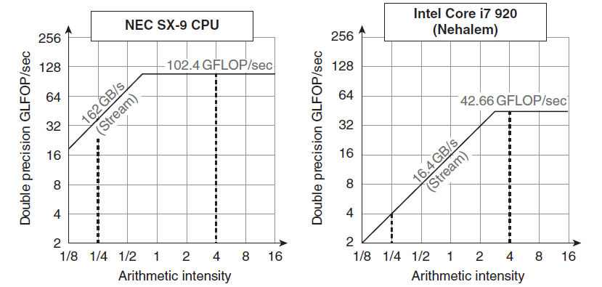
SIMD Instruction Set Extensions for Multimedia
The Roofline Visual Performance Model

Slide 13
SIMD Instruction Set Extensions for Multimedia
Arithmetic intensity, specified as the number of floating-point operations to run the program divided by the number of bytes accessed in main memory.
The above figure shows the Roofline model for the NEC SX-9 vector processor on the left and the Intel Core i7 920 multicore computer on the right.
The vertical Y-axis is achievable floating-point performance from 2 to 256 GFLOP/sec.
The horizontal X-axis is arithmetic intensity, varying from 1/8th FLOP/DRAM byte accessed to 16 FLOP/ DRAM byte accessed in both graphs.

Slide 14
SIMD Instruction Set Extensions for Multimedia
The Roofline Visual Performance Model
For a given kernel, we can find a point on the X-axis based on its arithmetic intensity.
If we drew a vertical line through that point, the performance of the kernel on that computer must lie somewhere along that line. We can plot a horizontal line showing peak floating-point performance of the computer.
Obviously, the actual floating-point performance can be no higher than the horizontal line, since that is a hardware limit.
How could we plot the peak memory performance? Since the X-axis is FLOP/byte and the Y-axis is FLOP/sec, bytes/sec is just a diagonal line at a 45-degree angle in this figure. Hence, we can plot a third line that gives the maximum floating-point performance that the memory system of that computer can support for a given arithmetic intensity.

Slide 15

SIMD Instruction Set Extensions for Multimedia
The Roofline Visual Performance Model
The horizontal and diagonal lines give this simple model its name and indicate its value. The “Roofline” sets an upper bound on performance of a kernel depending on its arithmetic intensity.
If we think of arithmetic intensity as a pole that hits the roof, either it hits the flat part of the roof, which means performance is computationally limited, or it hits the slanted part of the roof, which means performance is ultimately limited by memory bandwidth.
In the earlier Figure, the vertical dashed line on the right (arithmetic intensity of 4) is an example of the former and the vertical dashed line on the left (arithmetic intensity of 1/4) is an example of the latter.
Given a Roofline model of a computer, you can apply it repeatedly, since it doesn’t vary by kernel.

Slide 16
SIMD Instruction Set Extensions for Multimedia
The Roofline Visual Performance Model
Note that the “ridge point,” where the diagonal and horizontal roofs meet, offers an interesting insight into the computer.
If it is far to the right, then only kernels with very high arithmetic intensity can achieve the maximum performance of that computer. If it is far to the left, then almost any kernel can potentially hit the maximum performance.
Earlier Figure shows that the peak computational performance of the SX-9 is 2.4× faster than Core i7, but the memory performance is 10× faster.
For programs with an arithmetic intensity of 0.25, the SX-9 is 10× faster (40.5 versus 4.1 GFLOP/sec). The higher memory bandwidth moves the ridge point from 2.6 in the Core i7 to 0.6 on the SX-9, which means many more programs can reach peak computational performance on the vector processor.

